Slide 1

ER Diagram
Team 2
Krunal Bhavsar | Shrija Reddy | Tom Alex | Suruchi Patil | Tom Cookson | Ruchi Sharma | Chetan Besnat | Shubham Mittal | Swayambhu Dhuri

Slide 2
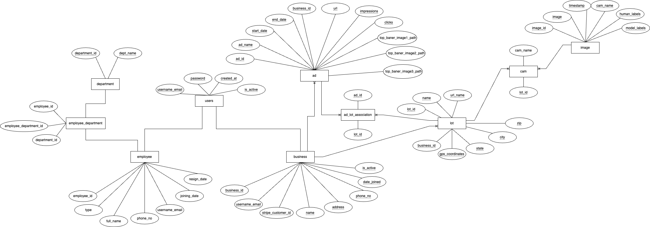
Conceptual diagram

Slide 3
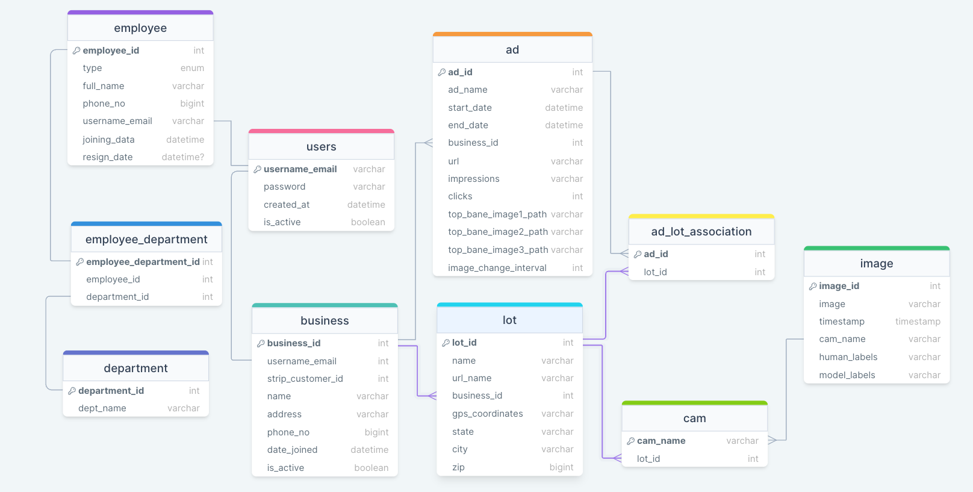
Logical diagram

